Slide 1
Modeling and Simulation of Magnetic Transmission Lines
Muhammad Shamaas
2018-MS-EE-4
Supervisor: Dr. Muhammad Asghar Saqib

Slide 2
Research Objectives
Model and Simulate dispersive, lossy and gyromagnetic Ferrites.
Analyze the relation between Magnetomotive force and Magnetic Flux rate for Magnetic Transmission Lines.
Study the causes and effects of signal delay, distortion and attenuation in Magnetic Transmission Lines.
Investigate the effects of frequency dependent conductivity and permeability on Flux Leakage and Core losses.
Study the transient effects of microwave Frequency ferromagnetic resonance in saturated gyromagnetic Ferrites.

Slide 3
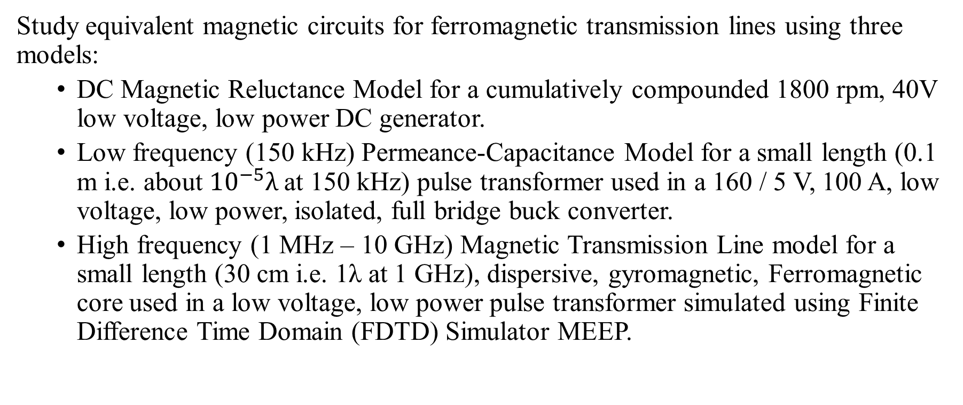
Presentation Outline
Study equivalent magnetic circuits for ferromagnetic transmission lines using three models:
DC Magnetic Reluctance Model for a cumulatively compounded 1800 rpm, 40V low voltage, low power DC generator.
Low frequency (150 kHz) Permeance-Capacitance Model for a small length (0.1 m i.e. about ${10}^{−5}λ$at 150 kHz) pulse transformer used in a 160 / 5 V, 100 A, low voltage, low power, isolated, full bridge buck converter.
High frequency (1 MHz – 10 GHz) Magnetic Transmission Line model for a small length (30 cm i.e. 1λ at 1 GHz), dispersive, gyromagnetic, Ferromagnetic core used in a low voltage, low power pulse transformer simulated using Finite Difference Time Domain (FDTD) Simulator MEEP.

Slide 4
1. Introduction to Magnetic Transmission

Slide 5
1. Introduction to Magnetic Transmission Lines
Magnetic Transmission Lines transmit information through Magnetic Flux which acts as the effective Magnetic charge. Time varying magnetic flux results in a Magnetic Displacement Current inside the Transmission Line.
The operation of a Magnetic Transmission Line does not involve flow of magnetic or electric charges. They are very poor electrical conductors. However, changing Magnetic Fields produce Electric Fields which is stored in the dielectric medium.
Together, the Electric and Magnetic Fields transmit Energy along the direction of propagation.

Slide 6
1. Industrial Applications of Magnetic Transmission Lines
Inductors and Magnetic Amplifiers.
Filters and Pulse Transformers.
Alternating Current and Direct Current Machines.
Magnetic Memory, Spintronic and Nanomagnetic Logic Devices
Ferrite loaded Microstrip Patch Antennas, Directional Couplers and Magnetometers.
Induction Heaters and Magneto-resistive Sensors.
Gyromagnetic Devices, Microwave generators and Magnetic Resonance Imaging.

Slide 7
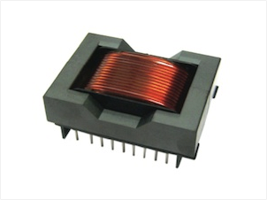
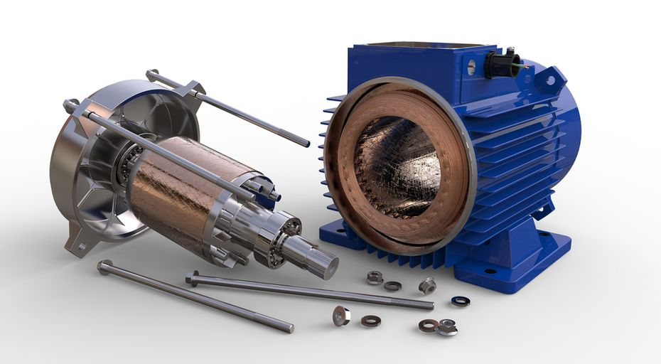
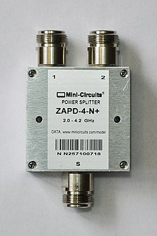
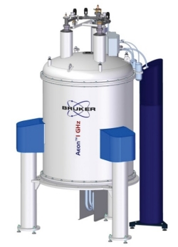
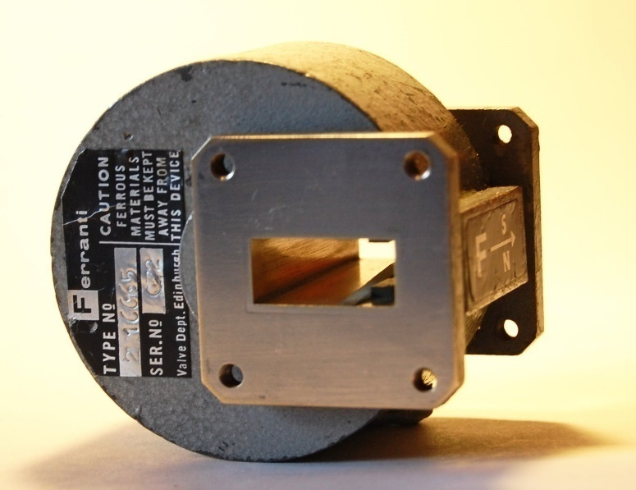
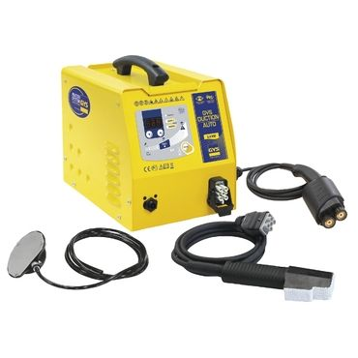
1. Industrial Applications of Magnetic Transmission Lines

Slide 8
1.1. Introduction to Solid State Magnetism

Slide 9
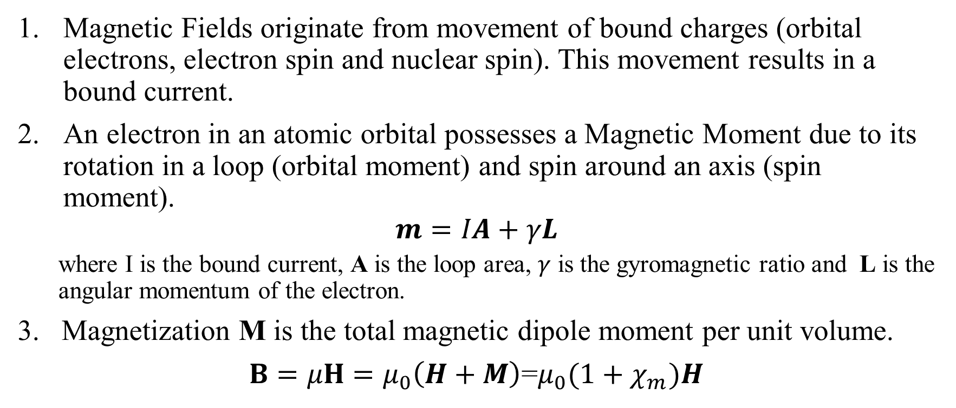
1.1. Magnetization and Permeability
Magnetic Fields originate from movement of bound charges (orbital electrons, electron spin and nuclear spin). This movement results in a bound current.
An electron in an atomic orbital possesses a Magnetic Moment due to its rotation in a loop (orbital moment) and spin around an axis (spin moment).
$$m=IA+γL$$
where I is the bound current, A is the loop area, $γ$ is the gyromagnetic ratio and L is the angular momentum of the electron.
3. Magnetization M is the total magnetic dipole moment per unit volume.
$B=μH=μ_{0}\left(H+M\right)$=$μ_{0}{(1+χ}_{m})H$

Slide 10
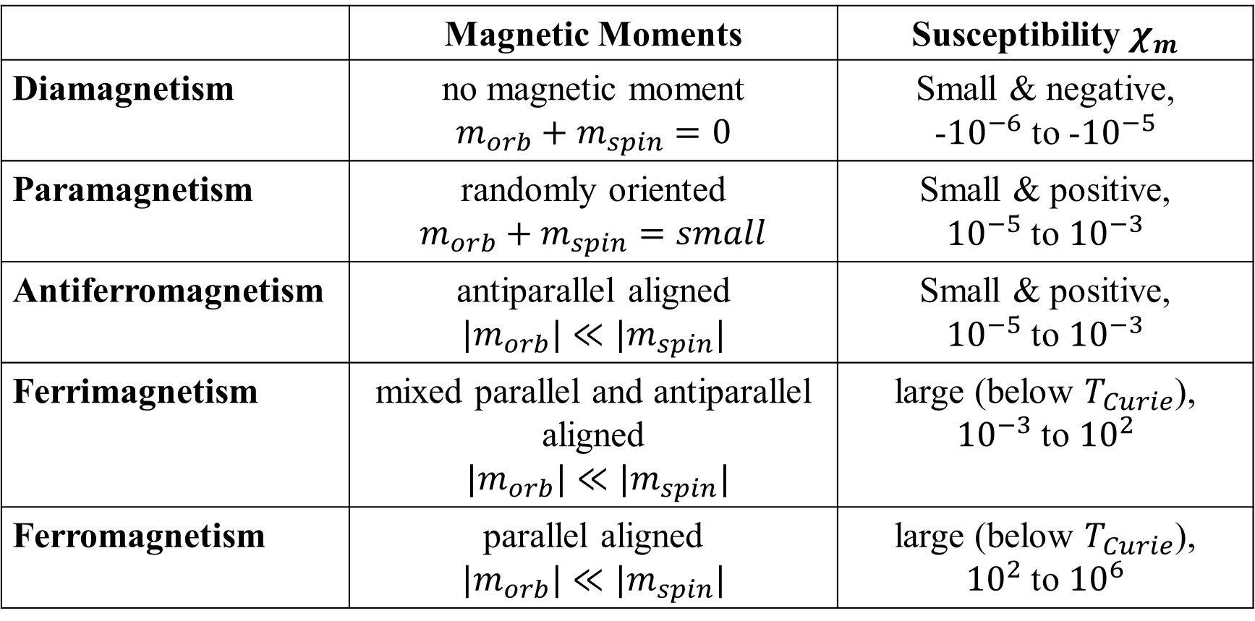
1.1. Properties of Magnetic Materials
 | Magnetic Moments | Susceptibility $χ_{m}$
Diamagnetism | no magnetic moment $$m_{orb}+m_{spin}=0$$ | Small & negative, -${10}^{−6}$ to -${10}^{−5}$
Paramagnetism | randomly oriented $$m_{orb}+m_{spin}=small$$ | Small & positive, ${10}^{−5}$ to ${10}^{−3}$
Antiferromagnetism | antiparallel aligned $$|m_{orb}|≪|m_{spin}|$$ | Small & positive, ${10}^{−5}$ to ${10}^{−3}$
Ferrimagnetism | mixed parallel and antiparallel aligned $$|m_{orb}|≪|m_{spin}|$$ | large (below $T_{Curie}$), ${10}^{−3}$ to ${10}^{2}$
Ferromagnetism | parallel aligned $$|m_{orb}|≪|m_{spin}|$$ | large (below $T_{Curie}$), ${10}^{2}$ to ${10}^{6}$

Slide 11
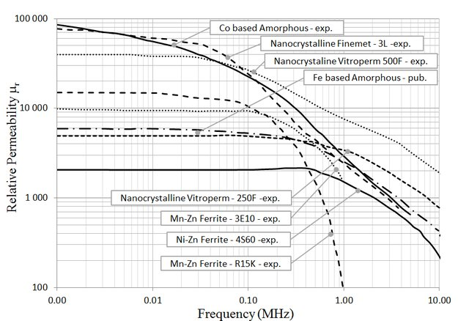
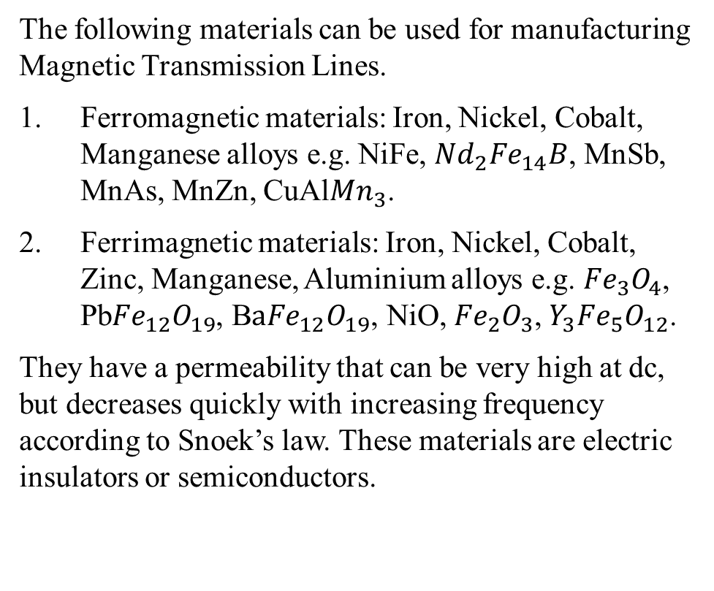
1.1. Sample Industrial Materials for Manufacturing Magnetic Transmission Lines
The following materials can be used for manufacturing Magnetic Transmission Lines.
Ferromagnetic materials: Iron, Nickel, Cobalt, Manganese alloys e.g. NiFe, ${Nd}_{2}{Fe}_{14}B$, MnSb, MnAs, MnZn, CuAl${Mn}_{3}$.
Ferrimagnetic materials: Iron, Nickel, Cobalt, Zinc, Manganese, Aluminium alloys e.g. ${Fe}_{3}O_{4}$, Pb${Fe}_{12}O_{19}$, B$a{Fe}_{12}O_{19}$, NiO, ${Fe}_{2}O_{3}$,${ Y}_{3}{Fe}_{5}O_{12}$.
They have a permeability that can be very high at dc, but decreases quickly with increasing frequency according to Snoek’s law. These materials are electric insulators or semiconductors.
Source: https://www.researchgate.net/publication/321357089_Magnetic_material_selection_for_EMI_filters/figures?lo=1

Slide 12
1.1. Magnetic Susceptibility
When a ferromagnetic material is magnetized, the susceptibility follows the a non-linear curve.
When the material is saturated, the magnetic susceptibility becomes zero.
Besides Magnetic Field Intensity, permeability is strongly dependent on chemical composition, crystal structure, stress, temperature and time after magnetization

Slide 13
1.1. Magnetic Hysteresis
Ferromagnetic materials are non-linear as their permeability varies with the strength of applied field intensity.
The flux in a ferromagnetic material depends on the instantaneous Magnetomotive force and its history.
At high magnetic field intensity, the material saturates, limiting further increase of Magnetic Flux.

Slide 14
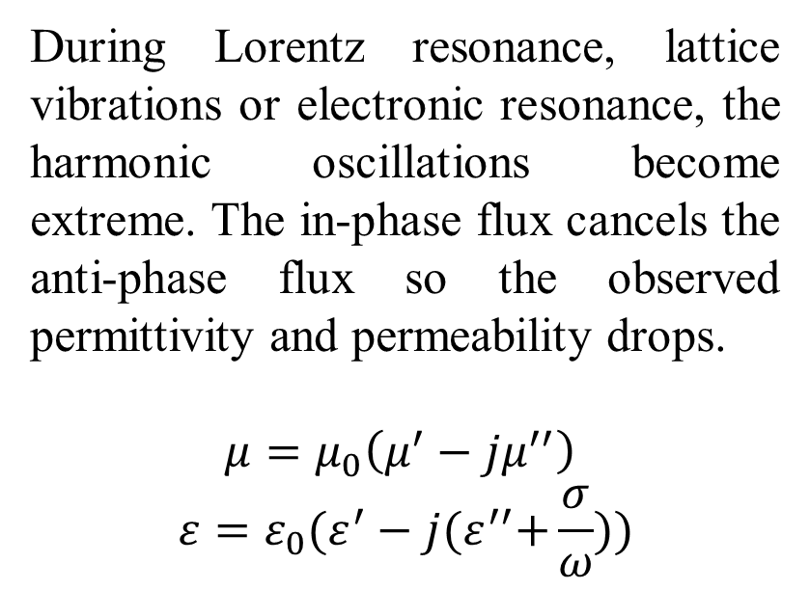
1.1. Dielectric and Diamagnetic Losses
During Lorentz resonance, lattice vibrations or electronic resonance, the harmonic oscillations become extreme. The in-phase flux cancels the anti-phase flux so the observed permittivity and permeability drops.
$$μ=μ_{0}\left(μ^{′}−jμ^{′′}\right)$$
$$ε=ε_{0}(ε^{′}−j{(ε}^{′′}+\frac{σ}{ω}))$$

Slide 15
1.1. Other Losses in Magnetic Cores
Non-linear, Frequency dependent energy loss effects in magnetic materials:
Core Residual Loss
Core Eddy Current Loss
Conductance Loss
Skin Effect Loss
Proximity Effect Loss
Self Capacitance Dielectric Loss
Self Capacitance Circulating Currents Loss

Slide 16
2. Magnetic Circuit Modeling

Slide 17
2. Three Magnetic Circuit Models
This chapter discusses three magnetic circuit models for Ferromagnetic Transmission Lines:
DC Non-linear Reluctance Model
Low Frequency Permeance-Capacitance Model
High Frequency Magnetic Transmission Line Model

Slide 18
2.1. Magnetic Reluctance Model

Slide 19
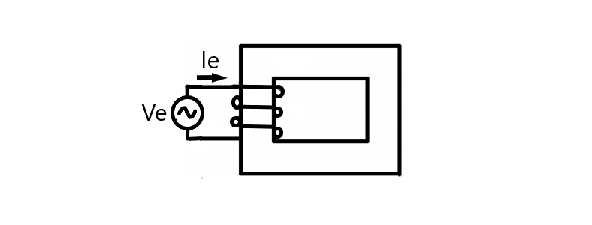
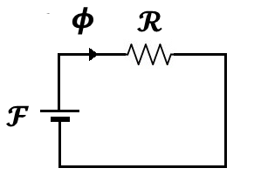
2.1. Complex Magnetic Reluctance Model for Magnetic Circuits (1873)

Slide 20
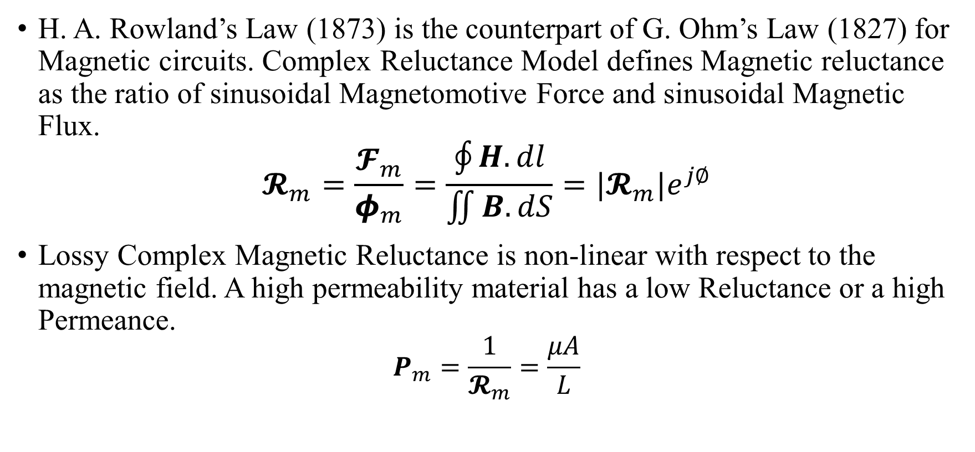
2.1. Complex Magnetic Reluctance Model for Magnetic Circuits (1873)
H. A. Rowland’s Law (1873) is the counterpart of G. Ohm’s Law (1827) for Magnetic circuits. Complex Reluctance Model defines Magnetic reluctance as the ratio of sinusoidal Magnetomotive Force and sinusoidal Magnetic Flux.
$$𝓡_{m}=\frac{𝓕_{m}}{φ_{m}}=\frac{\oint{H.dl}}{\iint{B.dS}}=|𝓡_{m}|e^{j∅}$$
Lossy Complex Magnetic Reluctance is non-linear with respect to the magnetic field. A high permeability material has a low Reluctance or a high Permeance.
$$P_{m}=\frac{1}{𝓡_{m}}=\frac{μA}{L}$$

Slide 21
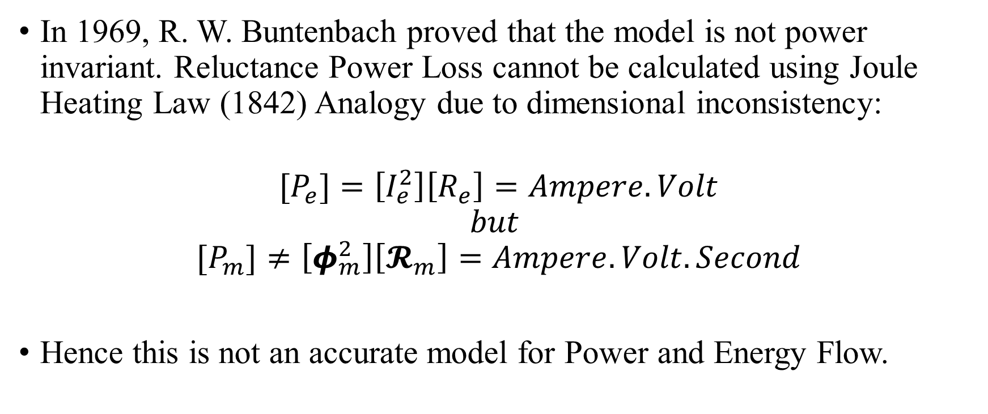
2.1. Inconsistency in Complex Magnetic Reluctance Model
In 1969, R. W. Buntenbach proved that the model is not power invariant. Reluctance Power Loss cannot be calculated using Joule Heating Law (1842) Analogy due to dimensional inconsistency:
$$[P_{e}]=\left[I_{e}^{2}\right]\left[R_{e}\right]=Ampere.Volt$$
$$but$$
$${[P}_{m}]≠\left[φ_{m}^{2}\right]\left[𝓡_{m}\right]=Ampere.Volt.Second$$
Hence this is not an accurate model for Power and Energy Flow.

Slide 22
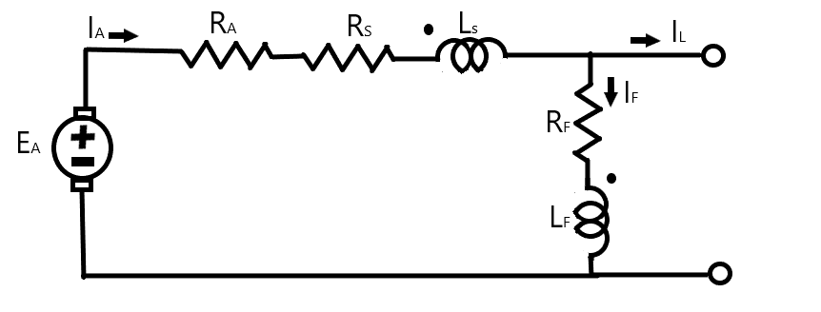
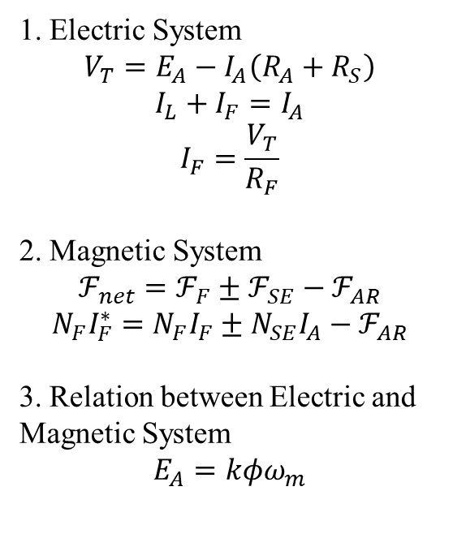
2.1. Reluctance model for a Compounded DC Generator
1. Electric System
$$V_{T}=E_{A}−I_{A}\left(R_{A}+R_{S}\right)$$
$$I_{L}+I_{F}=I_{A}$$
$$I_{F}=\frac{V_{T}}{R_{F}}$$
2. Magnetic System
$$ℱ_{net}=ℱ_{F}±ℱ_{SE}−ℱ_{AR}$$
$$N_{F}I_{F}^{∗}=N_{F}I_{F}±N_{SE}I_{A}−ℱ_{AR}$$
3. Relation between Electric and Magnetic System
$$E_{A}=kφω_{m}$$

Slide 23
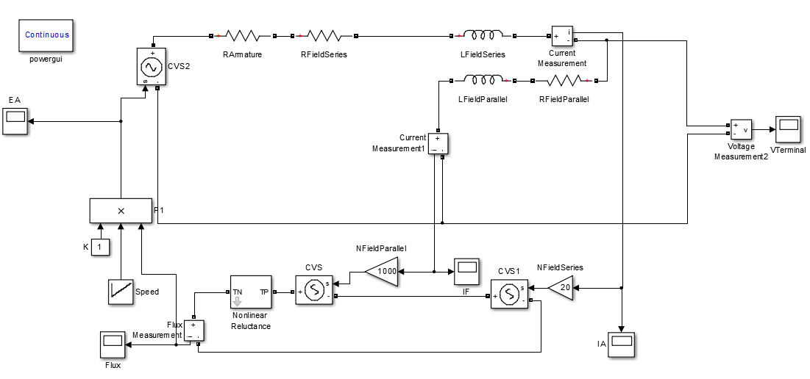
2.1. Simulation of Reluctance model for a Compounded DC Generator
Parameters:
R_{A}=0.19 Ω
R_{S}=0.02 Ω
R_{F}=20-50Ω
N_{F}=1000 turns
N_{S}=2000 turns
Rated speed=1800 rpm.
Rated Voltage=40 V.

Slide 24
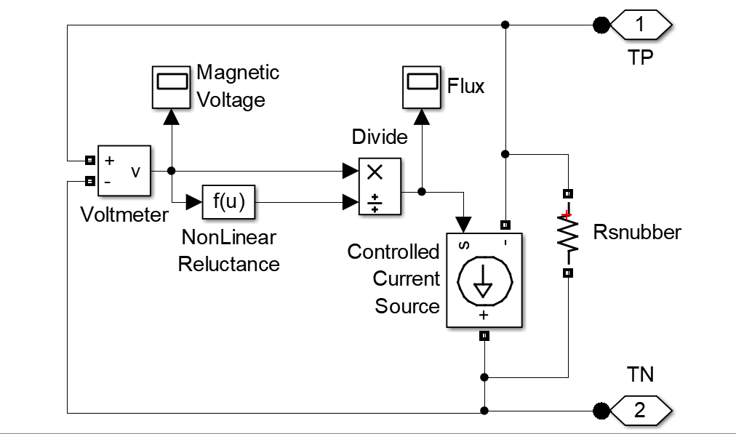
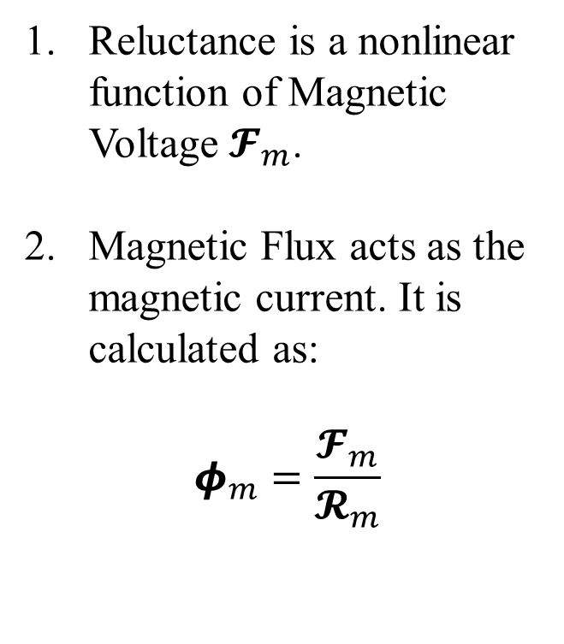
2.1. Simulation of Non-Linear Reluctance
Reluctance is a nonlinear function of Magnetic Voltage $𝓕_{m}$.
Magnetic Flux acts as the magnetic current. It is calculated as:
$$φ_{m}=\frac{𝓕_{m}}{𝓡_{m}}$$

Slide 25
2.1. Simulation of Non-Linear Reluctance

Slide 26
2.1. Simulation of Reluctance model for a Compounded DC Generator
The rotor mechanical speed was increased from 1000 to 2500 rpm in steps of 250rpm.
Reluctance model is only suitable for steady state simulations of machines if the reluctance profile of the magnetic core and the voltage/ flux relation is known.

Slide 27
2.2. Permeance-Capacitance Model

Slide 28
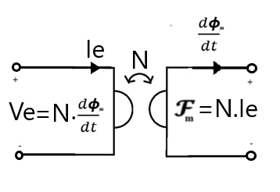
2.2. Tellegen’s Gyrator theory (1948)
B. Tellegen’s Gyrator theory (1948) can describe power invariant transformation of magnetic and electric quantities. The dual effort and flow quantities are related by the gyration constant N.

Slide 29
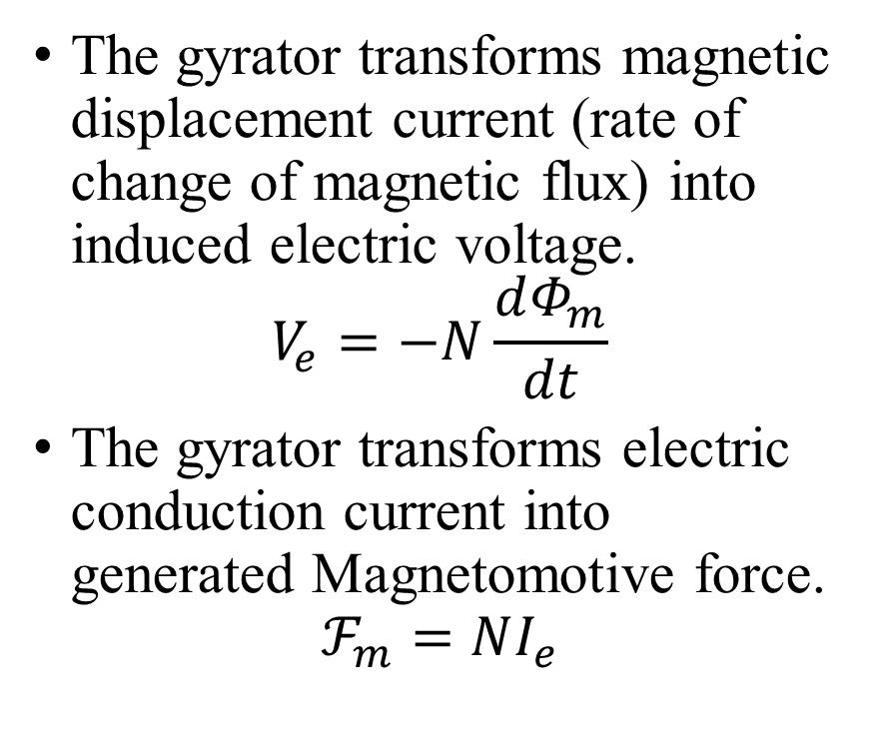
2.2. Tellegen’s Gyrator (1948)
The gyrator transforms magnetic displacement current (rate of change of magnetic flux) into induced electric voltage.
$$V_{e}=−N\frac{dΦ_{m}}{dt}$$
The gyrator transforms electric conduction current into generated Magnetomotive force.
$$ℱ_{m}=NI_{e}$$

Slide 30
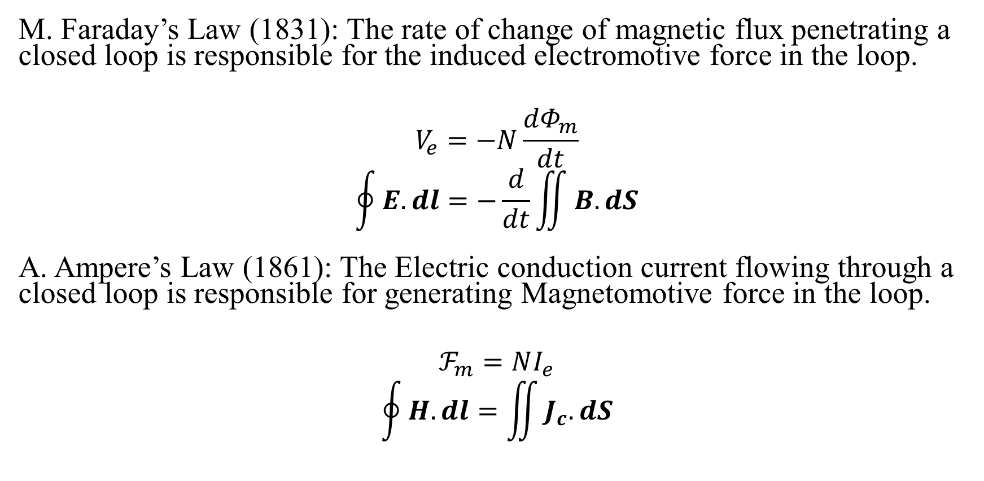
2.2. Validation of Gyrator Theory (1948)
M. Faraday’s Law (1831): The rate of change of magnetic flux penetrating a closed loop is responsible for the induced electromotive force in the loop.
$$V_{e}=−N\frac{dΦ_{m}}{dt}$$
$$\oint{E.dl}=−\frac{d}{dt}\iint{B.dS}$$
A. Ampere’s Law (1861): The Electric conduction current flowing through a closed loop is responsible for generating Magnetomotive force in the loop.
$$ℱ_{m}=NI_{e}$$
$$\oint{H.dl}=\iint{J_{c}.dS}$$

Slide 31
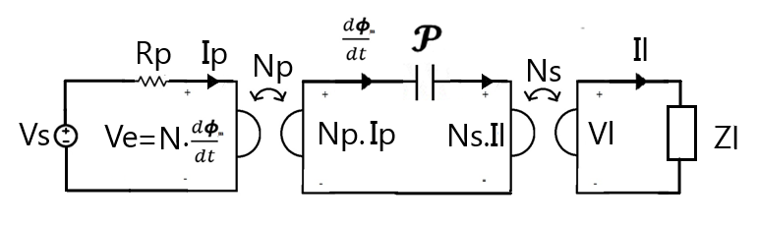
2.2. Power Invariant Permeance-Capacitance Model (1969)
R. W. Buntenbach proposed Power Invariant Permeance-Capacitance Model (1969) to replace Reluctance Model.
Magnetic Displacement Current is the rate of change of Magnetic Flux which results from the polarization of Magnetic Dipoles.

Slide 32
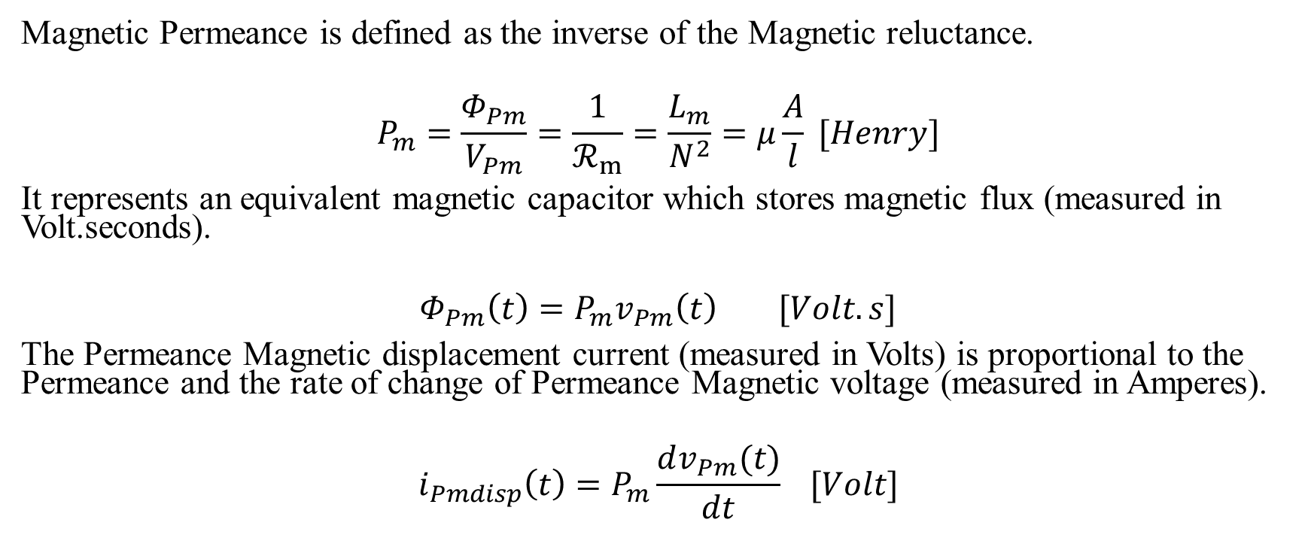
2.2. Magnetic Permeance
Magnetic Permeance is defined as the inverse of the Magnetic reluctance.
$$P_{m}=\frac{Φ_{Pm}}{V_{Pm}}=\frac{1}{ℛ_{m}}=\frac{L_{m}}{N^{2}}=μ\frac{A}{l} [Henry]$$
It represents an equivalent magnetic capacitor which stores magnetic flux (measured in Volt.seconds).
$$Φ_{Pm}\left(t\right)=P_{m}v_{Pm}\left(t\right) [Volt.s]$$
The Permeance Magnetic displacement current (measured in Volts) is proportional to the Permeance and the rate of change of Permeance Magnetic voltage (measured in Amperes).
$$i_{Pmdisp}\left(t\right)=P_{m}\frac{dv_{Pm}(t)}{dt} [Volt]$$

Slide 33
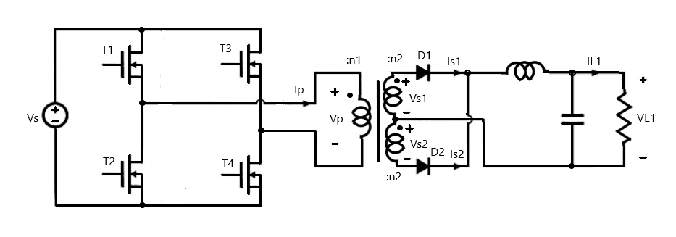
2.2. Permeance-Capacitance Model for a full bridge Isolated Buck Converter

Slide 34
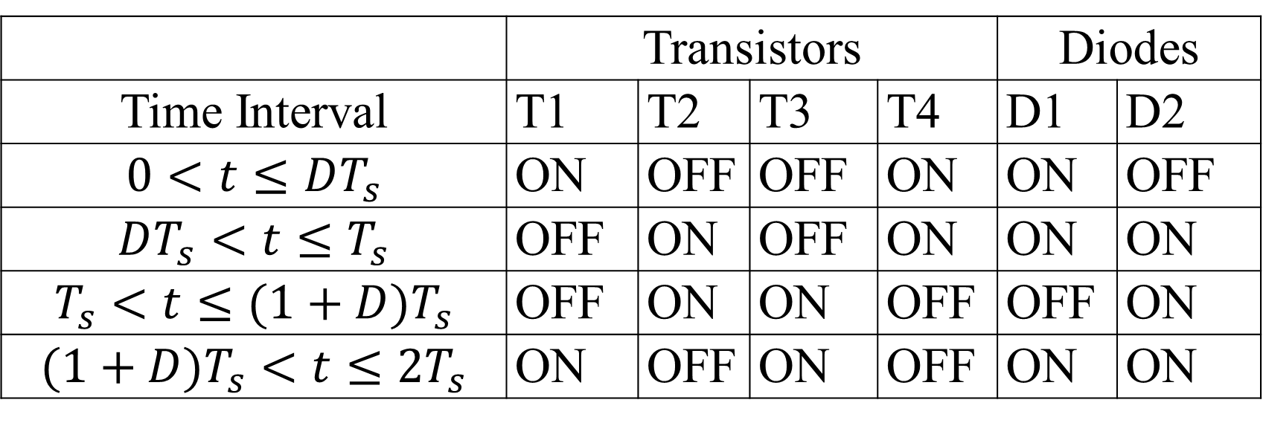
2.2. The switching table for the switches and diodes
 | Transistors |  |  |  | Diodes
Time Interval | T1 | T2 | T3 | T4 | D1 | D2
$$0<t≤DT_{s}$$ | ON | OFF | OFF | ON | ON | OFF
$$DT_{s}<t≤T_{s}$$ | OFF | ON | OFF | ON | ON | ON
$$T_{s}<t≤(1+D)T_{s}$$ | OFF | ON | ON | OFF | OFF | ON
$$(1+D)T_{s}<t≤2T_{s}$$ | ON | OFF | ON | OFF | ON | ON

Slide 35
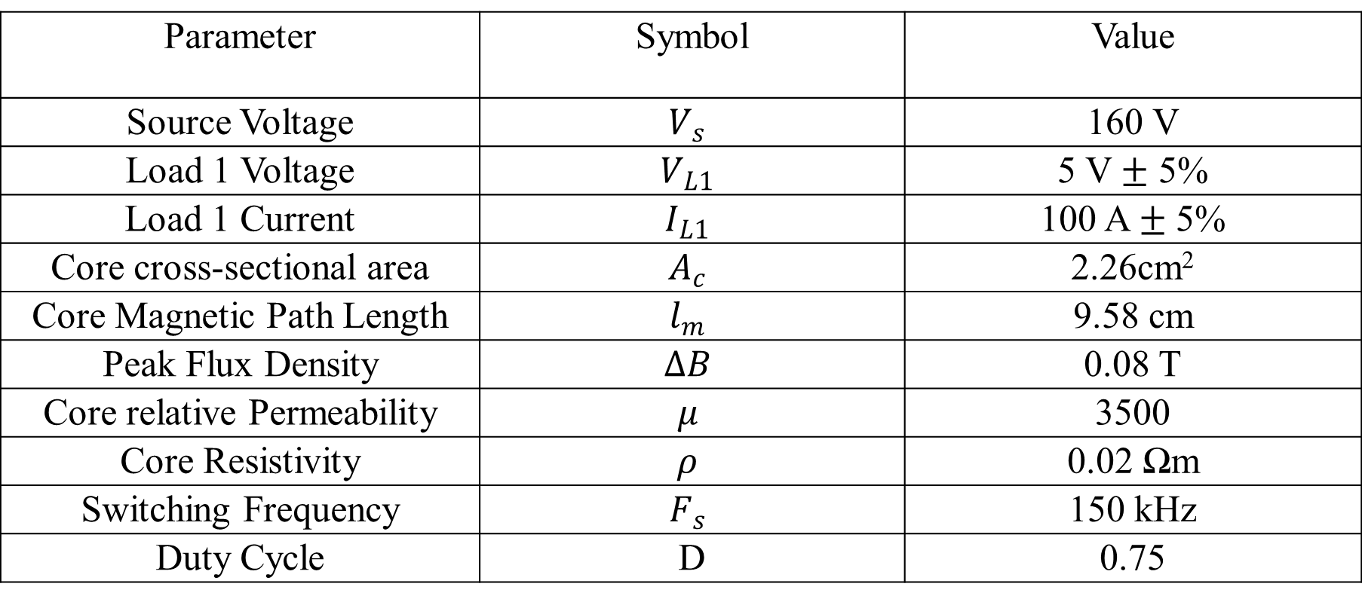
2.2. The design parameters
Parameter | Symbol | Value
Source Voltage | $$V_{s}$$ | 160 V
Load 1 Voltage | $$V_{L1}$$ | 5 V $±$ 5%
Load 1 Current | $$I_{L1}$$ | 100 A $±$ 5%
Core cross-sectional area | $$A_{c}$$ | 2.26cm²
Core Magnetic Path Length | $$l_{m}$$ | 9.58 cm
Peak Flux Density | $$∆B$$ | 0.08 T
Core relative Permeability | $$μ$$ | 3500
Core Resistivity | $$ρ$$ | 0.02 Ωm
Switching Frequency | $$F_{s}$$ | 150 kHz
Duty Cycle | D | 0.75

Slide 36
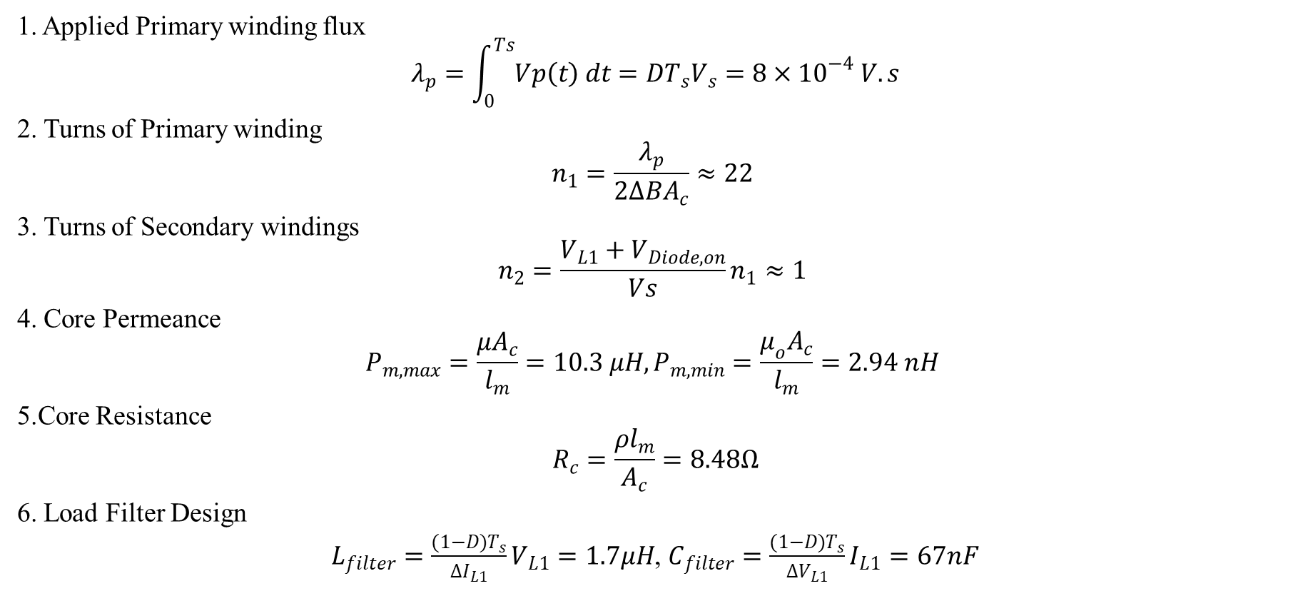
2.2. The Design Procedure
1. Applied Primary winding flux
$$λ_{p}=\int_{0}^{Ts}{Vp\left(t\right) dt}=DT_{s}V_{s}=8×{10}^{−4} V.s$$
2. Turns of Primary winding
$$n_{1}=\frac{λ_{p}}{2∆BA_{c}}≈22$$
3. Turns of Secondary windings
$$n_{2}=\frac{V_{L1}+V_{Diode,on}}{Vs}n_{1}≈1$$
4. Core Permeance
$$P_{m,max}=\frac{μA_{c}}{l_{m}}=10.3 μH, P_{m,min}=\frac{μ_{o}A_{c}}{l_{m}}=2.94 nH$$
5.Core Resistance
$$R_{c}=\frac{ρl_{m}}{A_{c}}=8.48Ω$$
6. Load Filter Design
$L_{filter}=\frac{(1−D)T_{s}}{∆I_{L1}}V_{L1}=1.7μH$, $C_{filter}=\frac{(1−D)T_{s}}{∆V_{L1}}I_{L1}=67nF$

Slide 37
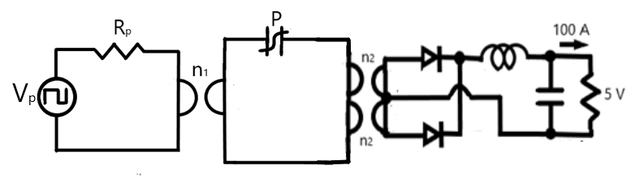
2.2. Permeance-Capacitance Model for a full bridge Isolated Buck Converter

Slide 38
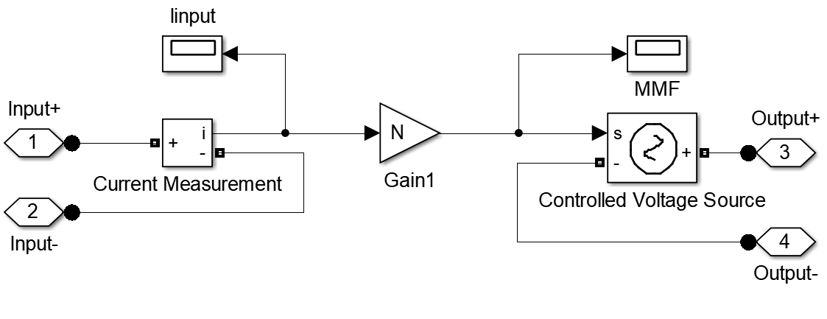
2.2. Model for Primary winding gyrator

Slide 39
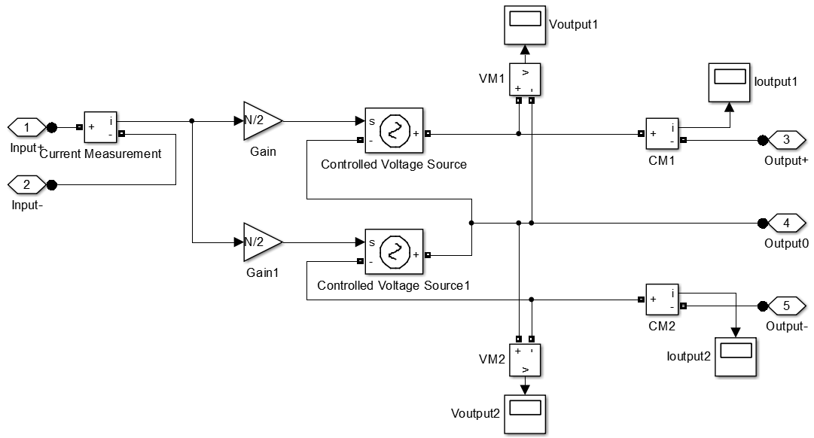
2.2. Model for Secondary winding gyrators

Slide 40
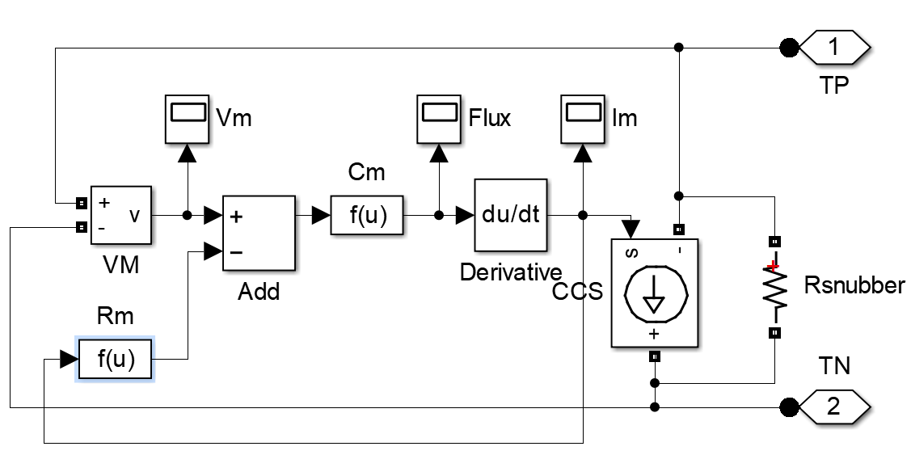
2.2. Model for non-linear Permeance

Slide 41
2.2. Sample Response of non-linear Permeance

Slide 42
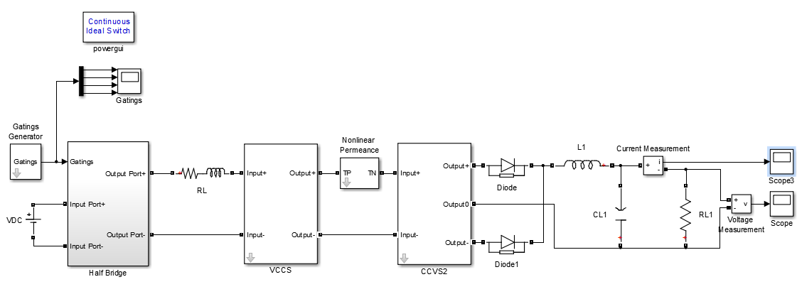
2.2. Simulation Model of full bridge Isolated Buck Converter

Slide 43
2.2. Source and Load waveforms

Slide 44
2.2. Permeance Magnetic Voltage and Magnetic Displacement Current
The Permeance-Capacitance model uses a non-linear Permeance to model nonlinearity and hysteresis losses of magnetic materials.
It is valuable for simulating transient behavior of Ferromagnetic elements like RF inductors, transformers and filters.

Slide 45
2.3.Magnetic Transmission Line Model

Slide 46
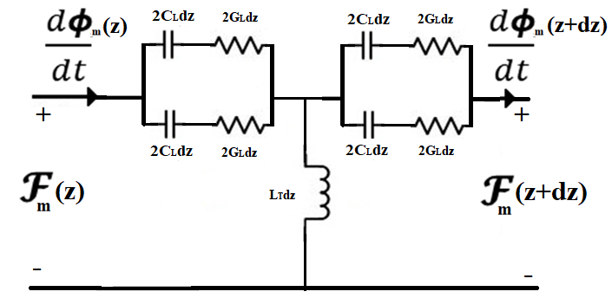
2.3. Magnetic Transmission Line Model (2012)
J. A. B. Faria and M.P. Pires presented Magnetic Transmission Line Model (2012) based on Electric Transmission Line Model in terms of per unit length Transverse Impedance and per unit length Longitudinal Admittance.

Slide 47
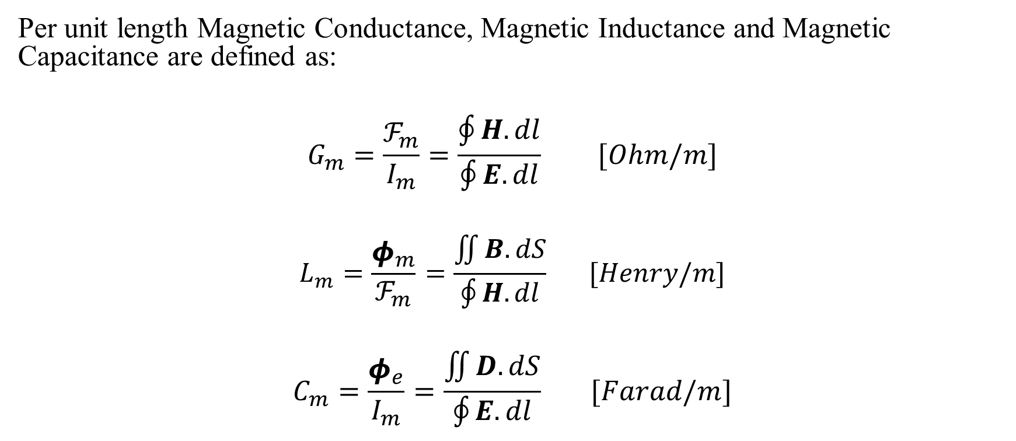
2.3. Distributed Parameters in Magnetic Transmission Line Model (2012)
Per unit length Magnetic Conductance, Magnetic Inductance and Magnetic Capacitance are defined as:
$$G_{m}=\frac{ℱ_{m}}{I_{m}}=\frac{\oint{H.dl}}{\oint{E.dl}} [Ohm/m]$$
$$L_{m}=\frac{φ_{m}}{ℱ_{m}}=\frac{\iint{B.dS}}{\oint{H.dl}} [Henry/m]$$
$$C_{m}=\frac{φ_{e}}{I_{m}}=\frac{\iint{D.dS}}{\oint{E.dl}} [Farad/m]$$

Slide 48
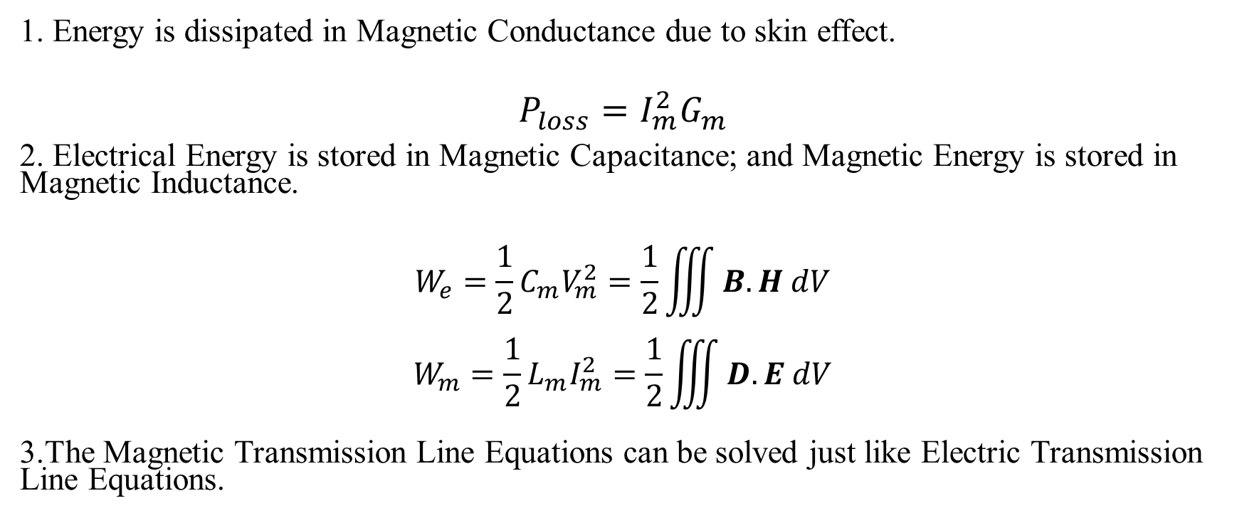
2.3. Energy Loss and Energy Storage in Magnetic Transmission Line Model (2012)
1. Energy is dissipated in Magnetic Conductance due to skin effect.
$$P_{loss}=I_{m}^{2}G_{m}$$
2. Electrical Energy is stored in Magnetic Capacitance; and Magnetic Energy is stored in Magnetic Inductance.
$$W_{e}=\frac{1}{2}{C_{m}V}_{m}^{2}=\frac{1}{2}\iiint{B.H dV}$$
$$W_{m}=\frac{1}{2}{L_{m}I}_{m}^{2}=\frac{1}{2}\iiint{D.E dV}$$
3.The Magnetic Transmission Line Equations can be solved just like Electric Transmission Line Equations.

Slide 49
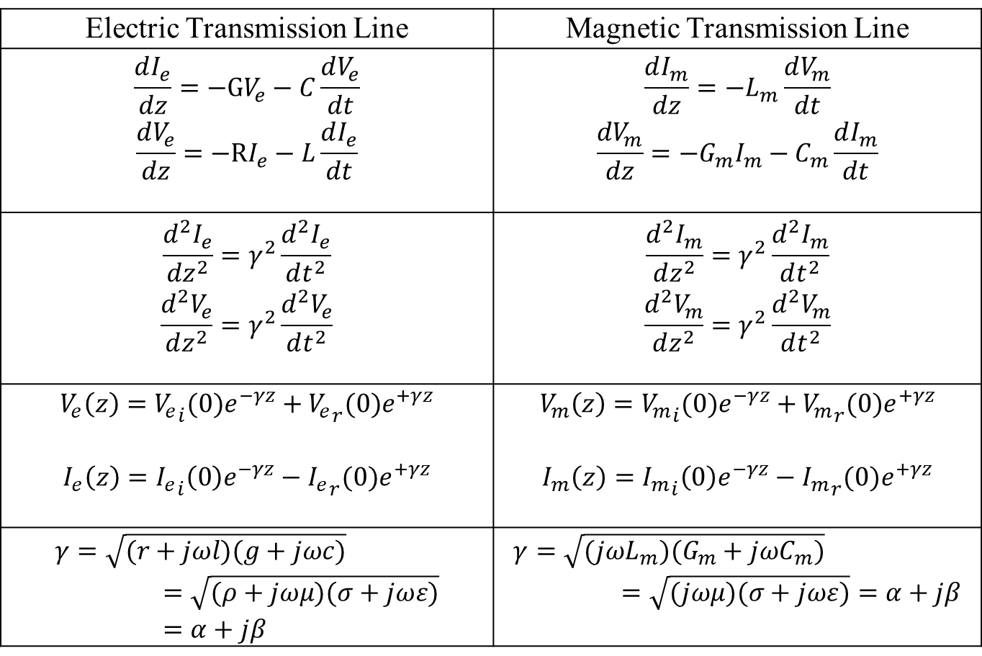
2.3. Lossy Transmission Lines
Electric Transmission Line | Magnetic Transmission Line
$$\frac{dI_{e}}{dz}=−GV_{e}−C\frac{dV_{e}}{dt}$$ $$\frac{dV_{e}}{dz}=−RI_{e}−L\frac{dI_{e}}{dt}$$ | $$\frac{dI_{m}}{dz}=−L_{m}\frac{dV_{m}}{dt}$$ $$\frac{dV_{m}}{dz}=−G_{m}I_{m}−C_{m}\frac{dI_{m}}{dt}$$
$$\frac{d^{2}I_{e}}{dz^{2}}=γ^{2}\frac{d^{2}I_{e}}{dt^{2}}$$ $$\frac{d^{2}V_{e}}{dz^{2}}=γ^{2}\frac{d^{2}V_{e}}{dt^{2}}$$ | $$\frac{d^{2}I_{m}}{dz^{2}}=γ^{2}\frac{d^{2}I_{m}}{dt^{2}}$$ $$\frac{d^{2}V_{m}}{dz^{2}}=γ^{2}\frac{d^{2}V_{m}}{dt^{2}}$$
$$V_{e}\left(z\right)={V_{e}}_{i}(0)e^{−γz}+{V_{e}}_{r}(0)e^{+γz}$$ $$I_{e}\left(z\right)={I_{e}}_{i}\left(0\right)e^{−γz}−{I_{e}}_{r}(0)e^{+γz}$$ | $$V_{m}\left(z\right)={V_{m}}_{i}(0)e^{−γz}+{V_{m}}_{r}(0)e^{+γz}$$ $$I_{m}\left(z\right)={I_{m}}_{i}\left(0\right)e^{−γz}−{I_{m}}_{r}(0)e^{+γz}$$
$$γ=\sqrt{(r+jωl)(g+jωc)}=\sqrt{(ρ+jωμ)(σ+jωε)}=α+jβ$$ | $$γ=\sqrt{(jωL_{m})(G_{m}+jωC_{m})}=\sqrt{(jωμ)(σ+jωε)}=α+jβ$$

Slide 50
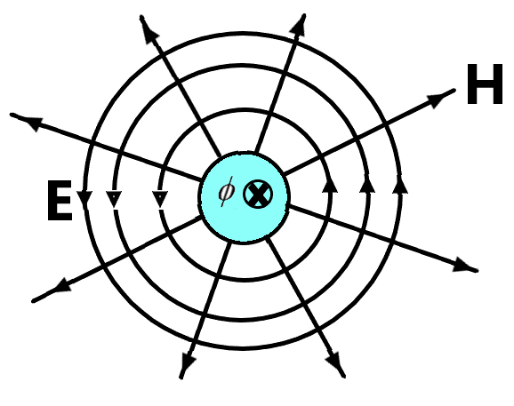
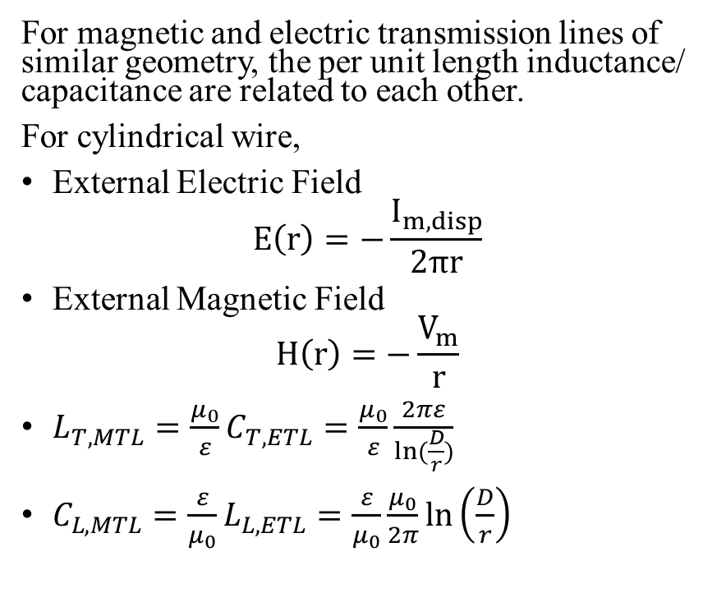
3.3. Per unit Length Transverse Inductance of Magnetic Transmission Line
For magnetic and electric transmission lines of similar geometry, the per unit length inductance/ capacitance are related to each other.
For cylindrical wire,
External Electric Field
$$E\left(r\right)=−\frac{I_{m,disp}}{2πr}$$
External Magnetic Field
$$H\left(r\right)=−\frac{V_{m}}{r}$$
$L_{T,MTL}=\frac{μ_{0}}{ε}C_{T,ETL}=\frac{μ_{0}}{ε}\frac{2πε}{ln⁡(\frac{D}{r})}$
$C_{L,MTL}=\frac{ε}{μ_{0}}L_{L,ETL}=\frac{ε}{μ_{0}}\frac{μ_{0}}{2π}\ln\left(\frac{D}{r}\right)$

Slide 51
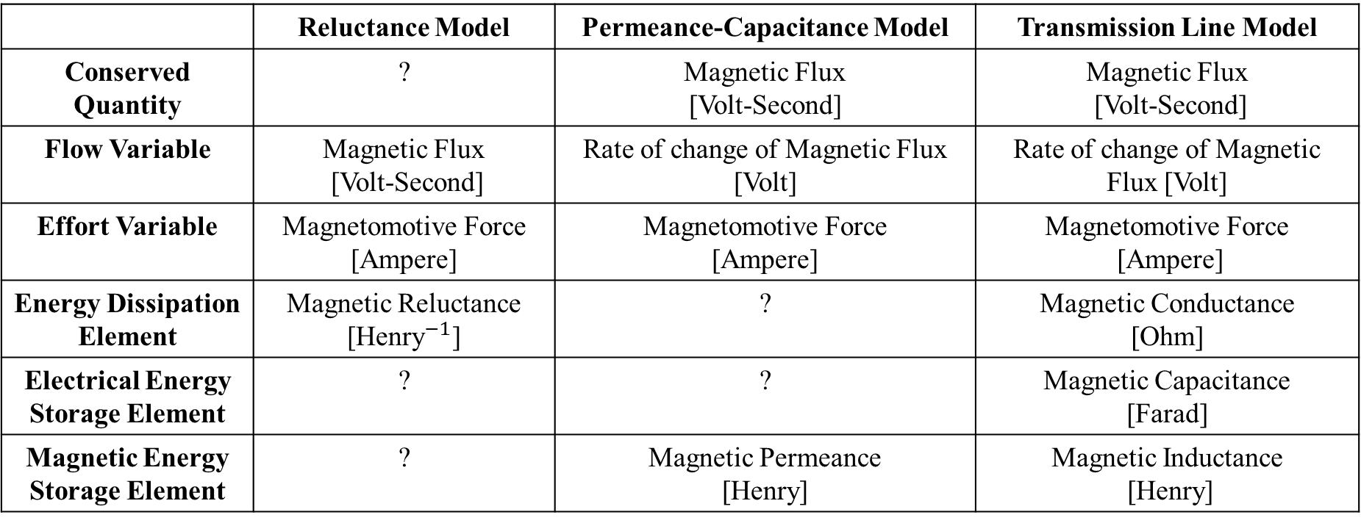
3.3. Comparison of three Models
 | Reluctance Model | Permeance-Capacitance Model | Transmission Line Model
Conserved Quantity | ? | Magnetic Flux [Volt-Second] | Magnetic Flux [Volt-Second]
Flow Variable | Magnetic Flux [Volt-Second] | Rate of change of Magnetic Flux [Volt] | Rate of change of Magnetic Flux [Volt]
Effort Variable | Magnetomotive Force [Ampere] | Magnetomotive Force [Ampere] | Magnetomotive Force [Ampere]
Energy Dissipation Element | Magnetic Reluctance [${\text{Henry}}^{−1}$] | ? | Magnetic Conductance [Ohm]
Electrical Energy Storage Element | ? | ? | Magnetic Capacitance [Farad]
Magnetic Energy Storage Element | ? | Magnetic Permeance [Henry] | Magnetic Inductance [Henry]

Slide 52
3. Electromagnetic Simulations and MEEP Simulator

Slide 53
3.1. Finite Difference Time Domain Method

Slide 54
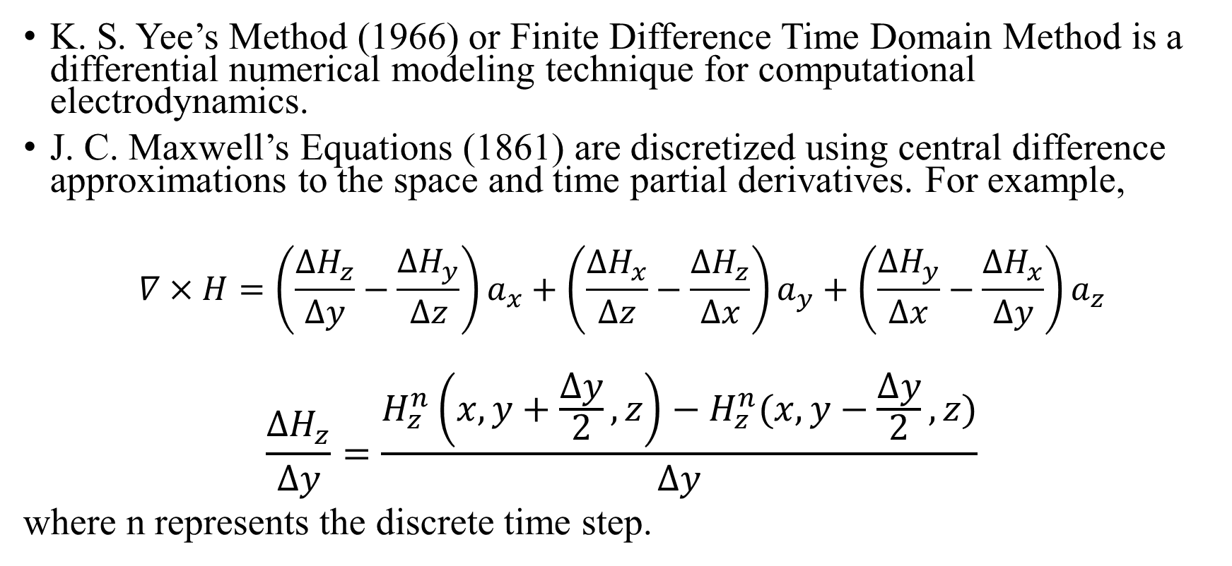
3.1. Finite Difference Time Domain Method (1966)
K. S. Yee’s Method (1966) or Finite Difference Time Domain Method is a differential numerical modeling technique for computational electrodynamics.
J. C. Maxwell’s Equations (1861) are discretized using central difference approximations to the space and time partial derivatives. For example,
$$∇×H=\left(\frac{∆H_{z}}{∆y}−\frac{∆H_{y}}{∆z}\right)a_{x}+\left(\frac{∆H_{x}}{∆z}−\frac{∆H_{z}}{∆x}\right)a_{y}+\left(\frac{∆H_{y}}{∆x}−\frac{∆H_{x}}{∆y}\right)a_{z}$$
$$\frac{∆H_{z}}{∆y}=\frac{H_{z}^{n}\left(x,y+\frac{∆y}{2},z\right)−H_{z}^{n}(x,y−\frac{∆y}{2},z)}{∆y}$$
where n represents the discrete time step.

Slide 55
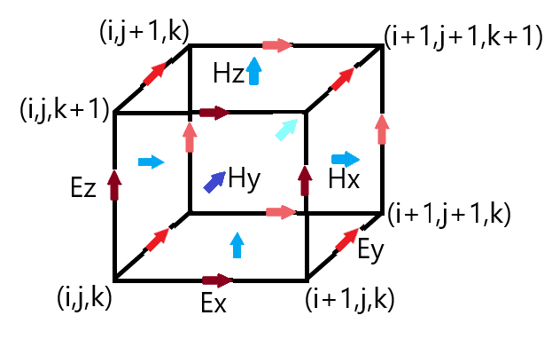
3.1. Yee Lattice (1966)
Finite Difference Time Domain Method discretizes space into a grid of small elements called Yee Lattice (1966). The different field components at a grid location are stored in the edges and faces of a cubic element. They are evolved in discrete time steps.

Slide 56
3.2. Introduction to MEEP Simulator

Slide 57
3.2. Introduction to MEEP Simulator
MEEP (2006) is a script based Simulator for modeling the time domain and frequency domain behavior of a variety of arbitrary materials including anisotropic, dispersive, non-linear and gyrotropic media.
C++ interface: Features variable resolution and normalized units.
Material Library: Sample data for several materials is provided in libraries for building accurate test structures.
Current Sources: A wide variety of electric or magnetic current sources can be simulated.
Derived components: Electric/ Magnetic/ Thermal Energy Density, Poynting Flux etc. can be evaluated.
Mathematical operations: Averaging, symmetry and integration are allowed in cylindrical and rectangular coordinates.
Data Visualization: The fields can be printed as image or video files.

Slide 58
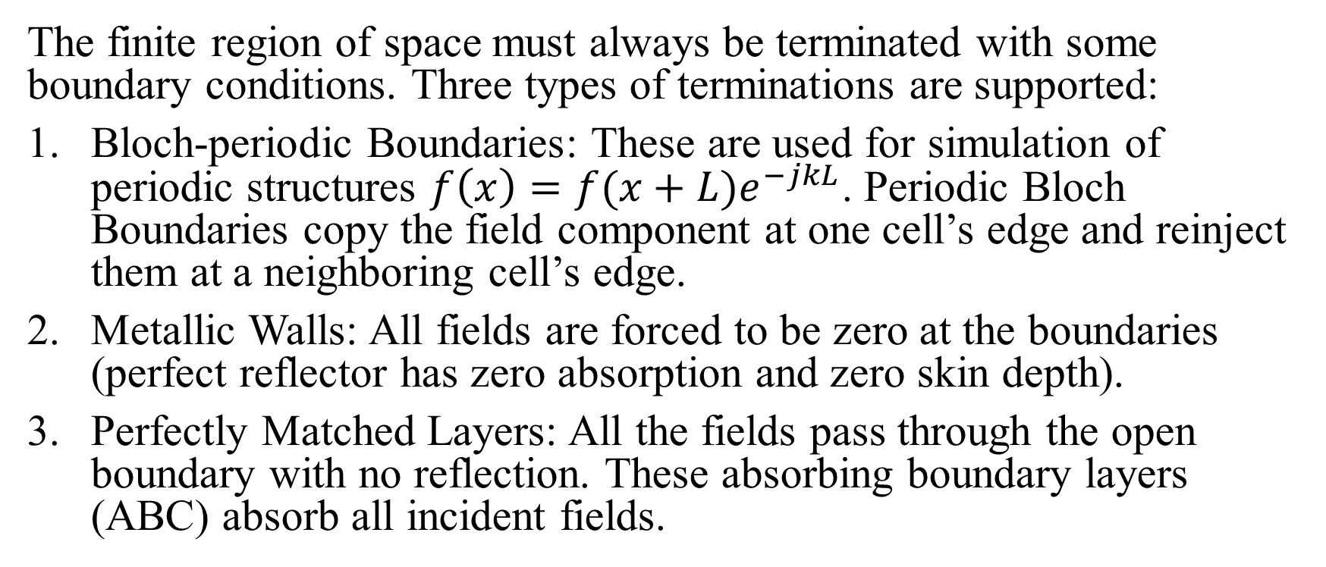
3.2. MEEP: Boundary Conditions
The finite region of space must always be terminated with some boundary conditions. Three types of terminations are supported:
Bloch-periodic Boundaries: These are used for simulation of periodic structures $f\left(x\right)=f(x+L)e^{−jkL}$. Periodic Bloch Boundaries copy the field component at one cell’s edge and reinject them at a neighboring cell’s edge.
Metallic Walls: All fields are forced to be zero at the boundaries (perfect reflector has zero absorption and zero skin depth).
Perfectly Matched Layers: All the fields pass through the open boundary with no reflection. These absorbing boundary layers (ABC) absorb all incident fields.

Slide 59
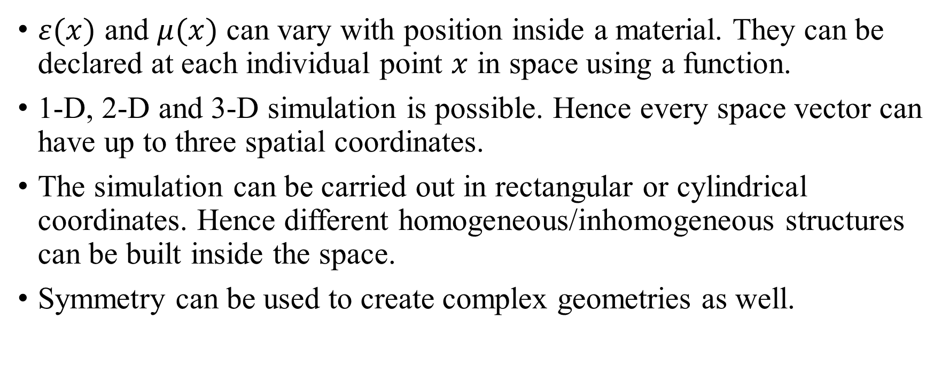
3.2. MEEP: Material Inhomogeneity
$ε(x)$ and $μ(x)$ can vary with position inside a material. They can be declared at each individual point $x$ in space using a function.
1-D, 2-D and 3-D simulation is possible. Hence every space vector can have up to three spatial coordinates.
The simulation can be carried out in rectangular or cylindrical coordinates. Hence different homogeneous/inhomogeneous structures can be built inside the space.
Symmetry can be used to create complex geometries as well.

Slide 60
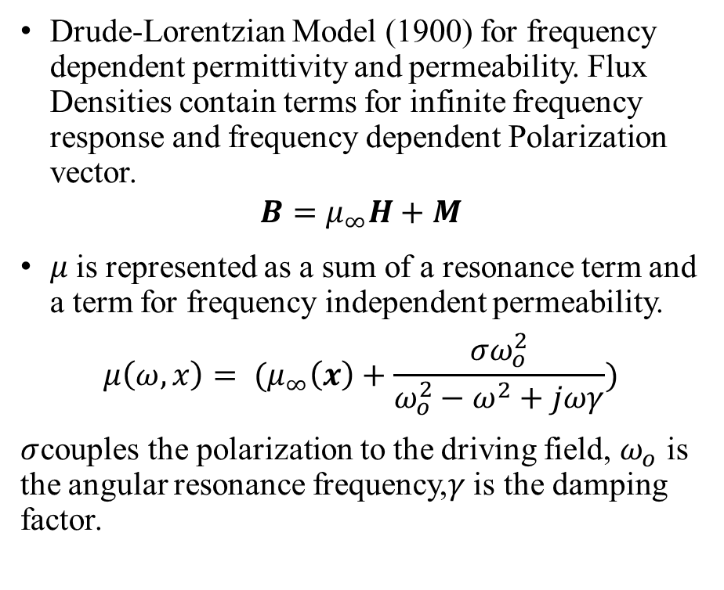
3.2. MEEP: Dispersion of Permeability
Drude-Lorentzian Model (1900) for frequency dependent permittivity and permeability. Flux Densities contain terms for infinite frequency response and frequency dependent Polarization vector.
$$B=μ_{∞}H+M$$
$μ$is represented as a sum of a resonance term and a term for frequency independent permeability.
$$μ\left(ω,x\right)= (μ_{∞}\left(x\right)+\frac{σω_{o}^{2}}{ω_{o}^{2}−ω^{2}+jωγ})$$
$σ$couples the polarization to the driving field, $ω_{o}$ is the angular resonance frequency,$γ$is the damping factor.

Slide 61
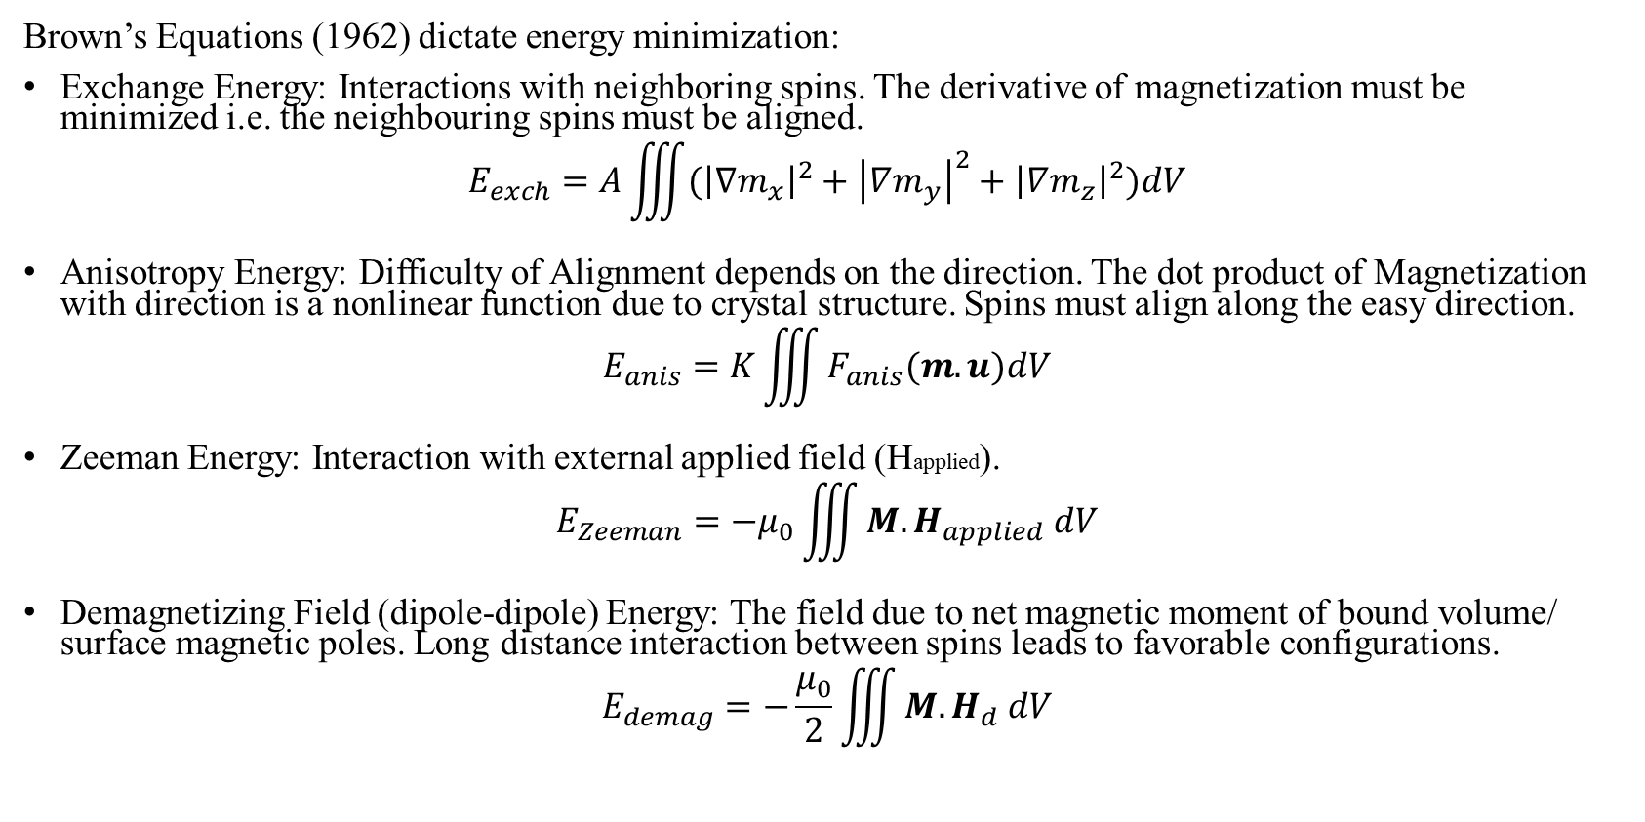
3.2. MEEP: Magnetic Energy Minimization Problem
Brown’s Equations (1962) dictate energy minimization:
Exchange Energy: Interactions with neighboring spins. The derivative of magnetization must be minimized i.e. the neighbouring spins must be aligned.
$$E_{exch}=A\iiint{({\left|∇m_{x}\right|}^{2}+{\left|∇m_{y}\right|}^{2}+{\left|∇m_{z}\right|}^{2})dV}$$
Anisotropy Energy: Difficulty of Alignment depends on the direction. The dot product of Magnetization with direction is a nonlinear function due to crystal structure. Spins must align along the easy direction.
$$E_{anis}=K\iiint{F_{anis}(m.u)dV}$$
Zeeman Energy: Interaction with external applied field (Happlied).
$$E_{Zeeman}=−μ_{0}\iiint{M.H_{applied} dV}$$
Demagnetizing Field (dipole-dipole) Energy: The field due to net magnetic moment of bound volume/ surface magnetic poles. Long distance interaction between spins leads to favorable configurations.
$$E_{demag}=−\frac{μ_{0}}{2}\iiint{M.H_{d} dV}$$

Slide 62
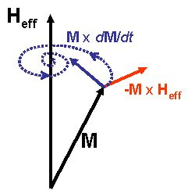
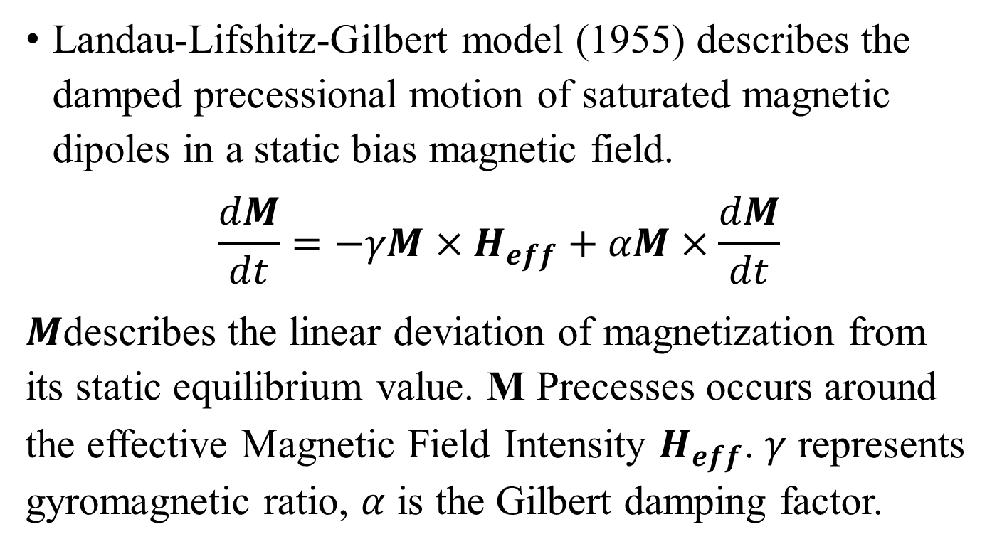
3.2. MEEP: Gyromagnetism
Landau-Lifshitz-Gilbert model (1955) describes the damped precessional motion of saturated magnetic dipoles in a static bias magnetic field.
$$\frac{dM}{dt}=−γM×H_{eff}+αM×\frac{dM}{dt}$$
$M$describes the linear deviation of magnetization from its static equilibrium value. M Precesses occurs around the effective Magnetic Field Intensity $H_{eff}$. $γ$ represents gyromagnetic ratio, $α$ is the Gilbert damping factor.

Slide 63



3.2. MEEP: Gyromagnetism
The Larmor Precession Frequency for Gyromagnetic materials placed in a static magnetic field has the relation:
$$ω_{p}=γB$$
Material | Gyromagnetic Ratio $γ$
Manganese – 53 ${}_{25}^{53}{Mn}$ | 10.94 MHz/T
Iron – 57 ${}_{26}^{57}{Fe}$ | 1.38 MHz/T
Cobalt – 59 ${}_{27}^{59}{Co}$ | 10.07 MHz/T
Nickel – 61 ${}_{28}^{61}{Ni}$ | 3.81 MHz/T
Zinc – 67 ${}_{30}^{67}{Zn}$ | 2.66 MHz/T
Source: http://kodu.ut.ee/~laurit/AK2/NMR_tables_Bruker2012.pdf

Slide 64

3.2. MEEP: Transmittance Spectra
Broadband response: The 3 Dimensional Discrete Fourier transform (1822) of the response to a short impulse can give useful information about the transmitted power and losses.
The Transmitted Power can be computed using the integral of Poynting Vector (1884); over a surface on the far end of the transmission line.
$$P\left(ω\right)=Re \{\hat{n}.\int{{E_{ω}\left(x\right)}^{∗}×H_{ω}\left(x\right)}d^{2}x\}$$
Transmitted power and incident power can be used to find power losses in transmission line.

Slide 65
3.3. MEEP Simulation of Dispersive, Gyromagnetic Ferromagnetic Transmission Line

Slide 66

3.3. MEEP Simulation for Magnetic Transmission Line
A pulse transformer was simulated in MEEP simulator. A Gyromagnetic, dispersive ferromagnetic MnZn core used for the simulation.
The microwave frequency Magnetic Transmission Line was excited using a small Gaussian soft electric current source.
Temporal and Spatial resolution
$$∆t=8.33 ps, ∆x=2.5mm$$
The multi-dimensional discrete Fourier transform (1822) was used to determine the Broadband Response and transmission line parameters.

Slide 67


3.3. Magnetic Transmission Line Model for Pulse Transformer
A pulse transformer passes a frequency band and is designed to handle complex waveforms like rectangular pulses.
It is used for impedance matching, voltage/ current transformation, DC isolation, mixing, power splitting, coupling and signal inversion.

Slide 68
3.3. Pulse Transformer Simulation in MEEP
A pulse transformer was excited by a small Gaussian soft electric current pulse to examine the Frequency Response. The 3 dimensional discrete Fourier Transform was used to determine Broadband Response.
Build Grid and Geometrical Structures for transformer, windings and boundaries.
Set 𝜀, 𝜇, 𝜎, Material Inhomogeneity, Dispersion and Non-Linearity Model Parameters.
Add volume current sources, set resolution and run Simulation for desired discrete steps.
Apply 3D Discrete Fourier Transform to find transmitted Poynting Flux and Broadband Response.

Slide 69

3.3. Geometry of Pulse Transformer
The primary winding was excited by a small Gaussian soft electric current pulse to examine the Frequency Response of electromagnetic power Transmission.
The power received at the secondary side was analyzed by measuring the received Poynting flux.

Slide 70

3.3. Material Properties of MnZn Ferrite
Gyrotropic Drude Permeability
$$μ_{r}\left(ω,x\right)= \left(μ_{r∞}+\frac{σω_{0}^{2}(ω_{0}^{2}−ω^{2}+jωγ)}{{(ω_{0}^{2}−ω^{2}+jωγ)}^{2}−ω^{2}b^{2}}\right)$$
$$μ_{r∞}\left(x\right)=1,σ={10}^{4},γ=\frac{3.3×{10}^{−3}}{2π},$$
$$f_{0}=1.73 MHz$$
Permittivity and Conductivity
$$ε=ε_{0}(ε^{′}−j\frac{σ}{ω})$$
$$ε^{′}=10,σ=5×{10}^{−3} S/m$$
Source: http://www.fair-rite.com/76-material-data-sheet/

Slide 71
3.3. Soft Magnetic Gaussian Current Pulse
A Gaussian soft magnetic current pulse Hz was applied on the primary side.
The Fourier Transform of the transverse Magnetic Field is shown for the range of 0 – 10 GHz.

Slide 72












3.3. Color map for Longitudinal Fields
 | X ↑ | Y ʘ | Z →
Magnetic Field Intensity H
Magnetic Flux Density B
Electric Field Intensity E
Electric Flux Density D

Slide 73













3.3. Color map for Transverse Fields
 | X ↑ | Y → | Z $×$
Magnetic Field Intensity H
Magnetic Flux Density B
Electric Field Intensity E
Electric Flux Density D

Slide 74

3.3. Field Map for Magnetic Transmission Line
The transverse E ﬁeld lines are closed, encircling the magnetic wire. The transverse H ﬁeld lines are open, starting at the magnetic wire.
1. Magnetic Displacement Current
$$I_{m,disp}=\frac{dΦ}{dt}=−\oint{E.dl}$$
2. Magnetic Voltage
$$V_{m}(z)=\int_{∞}^{r}{H_{r}(z).dr}$$

Slide 75
3.3. Evolution of Magnetic Voltage and Current
The soft electric Gaussian Pulse is communicated across the transmission line by the complex magnetic voltage and magnetic current.
The voltage and current have a phase displacement to transmit active and reactive power.

Slide 76


3.3. Evolution of Poynting Flux Density
The soft electric Gaussian Pulse lead to a sudden burst of energy.
The Poynting Flux Density in the direction of propagation $S_{z}$ represents the flow of power across the transmission line.
$$P=Re\{E×H^{∗}\}$$

Slide 77

3.3. Propagation Constant of Magnetic Transmission Line
The propagation constant was calculated by the following relation:
$$γ\left(jω\right)=\frac{−1}{L}ln\left(\frac{H_{x|z=L}\left(jω\right)}{H_{x|z=0}\left(jω\right)}\right)$$
$$γ\left(jω\right)=\sqrt{\left(jωμ\right)\left(σ_{e}+jωε\right)}$$
$$γ\left(jω\right)=\sqrt{Z_{T}Y_{L}}=α+jβ$$

Slide 78

3.3. Phase Velocity of Magnetic Transmission Line
The phase velocity and group velocity have the following relation:
$$v_{p}\left(ω\right)=\frac{ω}{β} , v_{g}\left(ω\right)=\frac{dω}{dβ}$$
Super-luminal phase velocity is exhibited near 100 MHz. The group velocity is ${10}^{8}m/s$ below 100MHz but it decreases after 100MHz.

Slide 79

3.3. Intrinsic Wave Impedance of Magnetic Transmission Line
The intrinsic wave impedance is given by
𝜂 $\left(jω\right)=\frac{E_{x}\left(jω\right)}{H_{x}\left(jω\right)}=\frac{V_{m}\left(jω\right)}{I_{m,disp}\left(jω\right)}$
𝜂 $\left(jω\right)=\sqrt{\frac{Z_{T}}{Y_{L}}}=\sqrt{\frac{jωμ}{σ_{e}+jωε}}$
The intrinsic impedance drops progressively as the permeability decreases.

Slide 80

3.3. Longitudinal Admittance of Magnetic Transmission Line
The Longitudinal Admittance was calculated using the following relation:
$$Y_{L}\left(jω\right)=\frac{γ(jω)}{\text{η}(jω)}=\frac{\sqrt{Z_{T}Y_{L}}}{\sqrt{{Z_{T}/Y}_{L}}}$$
$$Y_{L}\left(jω\right)=G_{L}+jωC_{L}$$

Slide 81

3.3. Transverse Impedance of Magnetic Transmission Line
The Transverse Impedance was calculated using the following relation
$$Z_{T}\left(jω\right)=\text{η}\left(jω\right)γ\left(jω\right)$$
$$Z_{T}\left(jω\right)=\sqrt{{Z_{T}/Y}_{L}}\sqrt{{Z_{T}Y}_{L}}=jωL_{T}$$

Slide 82
3.3. Ferromagnetic Resonance in Saturated Gyromagnetic Ferrite
Ferromagnetic resonance is coupling between an electromagnetic wave and the magnetization of a medium through which it passes. This coupling induces a significant loss of power of the wave. The power is absorbed by the precessing magnetization of the material and lost as heat.
For this coupling to occur, the frequency of the incident wave must be equal to the precession frequency of the magnetization (Larmor frequency).
The FMR spectroscopic technique is a standard tool for probing spin waves and spin dynamics. FMR probes the sample magnetization resulting from the magnetic moments of dipolar-coupled but unpaired electrons.
The FMR resonance is also the basis of various high-frequency electronic devices, such as resonance isolators or circulators.

Slide 83

3.3. Dispersion of Gyromagnetic Susceptibility
For ferromagnetic media biased in the z-direction b=1 $\hat{z}$, a non-diagonal susceptibility tensor is used to relate Magnetization and Field intensity M= $χ$H.
$M=\left[\begin{matrix}χ_{⊥} & −jη & 0 \\ jη & χ_{⊥} & 0 \\ 0 & 0 & χ_{||}\end{matrix}\right]H$,
$χ_{⊥}$=$\frac{σ(ω_{0}−iωα)}{{(ω_{0}−iωα)}^{2}−{ (ω+iγ)}^{2}}$ ,
$η$= $\frac{σ(ω+iγ)}{{(ω_{0}−iωα)}^{2}−{(ω+iγ)}^{2}}$ , $χ_{||}$=$0$
The transmission line resonates when 1mm wavelength signal (300GHz) is applied.

Slide 84

3.3. Gyromagnetic Precession due to Sinusoidal Source
The Gyromagnetic Ferrite does not resonate when excited by a 225GHz linearly polarized sinusoid source.
Temporal and Spatial resolution
$$∆t=75 fs, ∆x=25um$$
The Polarization of the linearly Polarized wave changes as it moves across the saturated ferrite.

Slide 85

3.3. Gyromagnetic Resonance due to Gaussian Source
A Gaussian source was applied to find the broadband frequency response during gyromagnetic resonance.
Temporal and Spatial resolution:
$$∆t=75 fs, ∆x=25um$$
The Gaussian source had a bandwidth of 450GHz centered at 225GHz.
The strongest resonance was due to the 300GHz harmonic.

Slide 86
3.3. Intrinsic Impedance and Propagation Constant
The harmonic of the incident Gaussian wave equal to the precession frequency of the magnetization (Larmor frequency) gives rise to Gyromagnetic resonance.

Slide 87
3.3. Longitudinal Admittance and Transverse Impedance
During Gyromagnetic Resonance, the per unit length Longitudinal Admittance and Transverse Impedance spike by a factor of 100 times. This leads to a severe increase in the power dissipation in the Ferrite sample. The Transverse Inductance increases and Longitudinal Capacitance drops so the Reactive power consumption increases.

Slide 88
3.3. Limitations of MEEP simulation
The MEEP simulation was used to study power losses due to conduction of core loss and electromagnetic resonance. The results are only valid for small signal analysis of the Gyromagnetic, Dispersive, Ferromagnetic MnZn core.
The MEEP simulator was not used to model the following magnetic effects:
Magnetostriction effects
Acoustic effects
Non-linear Effects

Slide 89
4. Conclusion

Slide 90
4. Conclusion
The reluctance model is suitable for DC analysis of ferromagnetic materials. A DC Magnetic Reluctance Model for a cumulatively compounded 1800 rpm 40V low voltage/ power DC generator was presented.
The Permeance-Capacitance model is suitable for low frequency analysis of ferromagnetic materials. A Low frequency Permeance-Capacitance Model for 150kHz pulse transformer was used in a 160V to 5 V, 100 A low voltage/ power isolated full bridge buck converter.
The Magnetic Transmission Line Model is suitable for high frequency analysis of ferromagnetic materials. A High frequency low voltage/ power (30 cm i.e. 1λ at 1 GHz) gyromagnetic, dispersive Magnetic Transmission Line was simulated using Finite Difference Time Domain (FDTD) Simulator MEEP to study Frequency Domain Behavior of Magnetic Transmission Line parameters.

Slide 91
4. Scope for Further Work
Magnetic Transmission Lines behave like high pass filter hence they can realize high speed data transmission with minimal losses.
The power invariant Magnetic Transmission Line model can also be used for accurate modeling of
Alternating Current and Direct Current Machines
Nanomagnetic Logic Devices and Magnetic Transistors
Magnetic Memory Devices and Spintronic devices
Circulators, Couplers, Filters, Power Dividers and Waveguides
Gyromagnetic Non-Linear Transmission Line Microwave generators

Slide 92
References
[1] J. B. Faria, Multimodal propagation in multiconductor transmission lines. J. Electromag. Waves Appl. 2014, p. 1677–1702
[2] J. B. Faria, Formulation of Multiwire Magnetic Transmission-Line Theory, Progress in Electromagnetics Research B, Vol. 49, 2013, p. 177–195.
[3] J. B. Faria, Matrix theory of wave propagation in hybrid electric/magnetic multiwire transmission line systems, Journal of Electromagnetic Waves and Applications, Vol. 29, No. 7, 2015, p. 925–940.
[4] J. B. Faria, A physical model of the ideal transformer based on magnetic transmission line theory, Journal of Electromagnetic Waves and Applications, Vol. 27, No. 3, 2013, p. 365–373.
[5] J. B. Schneider, Understanding the Finite-Difference Time-Domain Method, 2017, p. 33-74.
[6] A. Oskooi, D. Roundy, M. Ibanescu, P. Bermel, J.D. Joannopoulos, and S.G. Johnson, MEEP: A flexible free-software package for electromagnetic simulations by the FDTD method, Computer Physics Communications, Vol. 181, 2010, p. 687-702.
[7] J. B. Faria, Complex reluctance of inhomogeneous Euler-Cauchy tubular ferrites taking into account frequency dependent complex permeability, Progress In Electromagnetics Research M, Vol. 25, 2012, p. 71–85.
[8] C. Paul, K. Whites and S. Nasar, Introduction to electromagnetic fields, 4th ed. Boston: WCB/McGraw-Hill, 1998, p.586-589.
[9] B. Sevcik and L. Brancık, Time-Domain Simulation of Nonuniform Multiconductor Transmission Lines in Matlab, International Journal of Mahematics and Computers in Simulation, Vol.5, No. 2, 2011, p. 1-8.

Slide 93
References
[10] G. Antonini, A general framework for the analysis of metamaterial transmission lines. Prog. Electromagn. Res. B., 2010, p. 353–373
[11] C. Caloz and T. Itoh, Electromagnetic Metamaterials: Transmission Line Theory and Microwave Applications, Wiley-IEEE Press, 2006, p. 27-58.
[12] IEEE, Standard for Validation of Computational Electromagnetic (CEM) Computer Modeling and Simulation, and Recommended Practice, Part I, IEEE, June 2008.
[13] C. Paul, Introduction to Electromagnetic Compatibility, 2nd ed. Kentucky: John Wiley and Sons, 2006, p. 559-710.
[14] L. Er-Ping, Computational Electromagnetics for Electromagnetic Compatibility/ Signal Integrity Analysis, IEEE EMC DL Talk, University of Missouri, 2008.
[15] T. C. Edwards and M. B. Steer, Foundations for Microstrip Circuit Design, 4th ed. Wiley-IEEE Press, 2016, p. 576-607.
[16] J. Dickens and A. Neuber, Material selection considerations for coaxial, ferrimagnetic-based nonlinear transmission lines, Journal of Applied Physics, 113, 064904, 2013, p. 1-5.
[17] J. Parson, A. Neuber, J. Dickens and J. Mankowski, Investigation of a stripline transmission line structure for gyromagnetic nonlinear transmission line high power microwave sources, Review of Scientific Instruments, 87, 034706, 2016, p. 1-7.
[18] G. Dominguez, Power-Invariant Magnetic System Modeling, PhD Disseration, Texas A&M University, 2011, p. 45-64.

